Slide 1

Python_Chatbot
Guided by Dr.S.Suthir Sir
Team 26

Slide 2
Team Members
 | Vivek Dharewa | 20BAI10032
 | Shivang Singh Negi | 20BAI10171
 | Ameya Shrikant | 20BAI10183
 | Tanay Singh | 20BAI10226

Slide 3



INDEX
1. Introduction
2. Existing work with limitations
3. Proposed work and methodology
4. Novelty of the project
5. Real time usage
6. Hardware & software requirements
7. Overall system architecture diagram

Slide 4


Introduction
Why Chatbot?
Trending topic from past several years
Best suited for intermediate programmers
A chatbot is an automated conversation partner. It facilitates a conversation between a human and a computer.
Types:
1. Rule-based Chatbots
2. Retrieval-based Chatbots
3. Deep-learning Chatbots

Slide 5
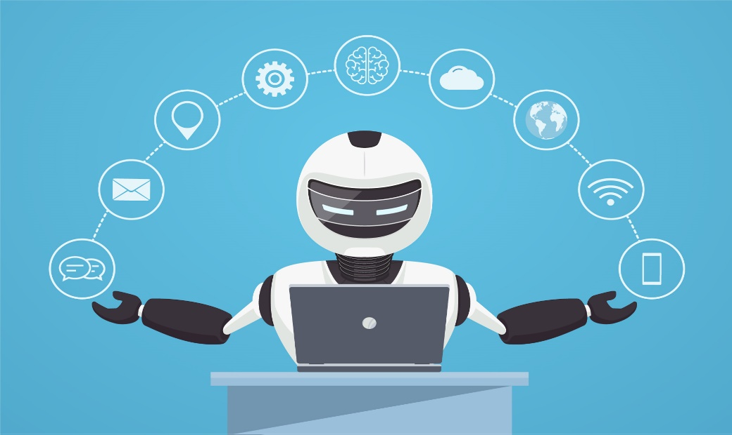
Existing Work with Limitations
Most modern chatbots use Natural language Processing (NLP) and machine learning (ML) to understand customer questions and automate responses to them, simulating human conversation.
A more notable growth is seen in AI-driven virtual assistant like Siri, Alexa, Google assistant, Cortana etc.

Slide 6
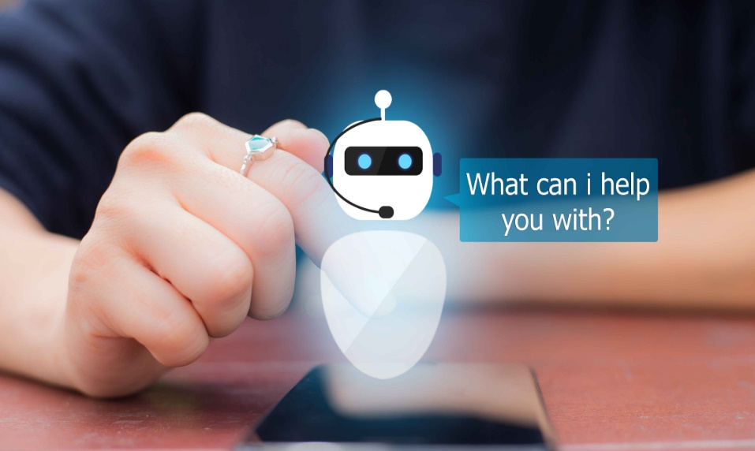
Some limitations of chatbots are:
As the database, used for output generation, is fixed and limited, chatbots can fail while dealing with an unsaved query.
A chatbot's efficiency highly depends on language processing and is limited because of irregularities, such as accents and mistakes.
Chatbots have difficulty managing non-linear conversations that must go back and forth on a topic with a user.

Slide 7
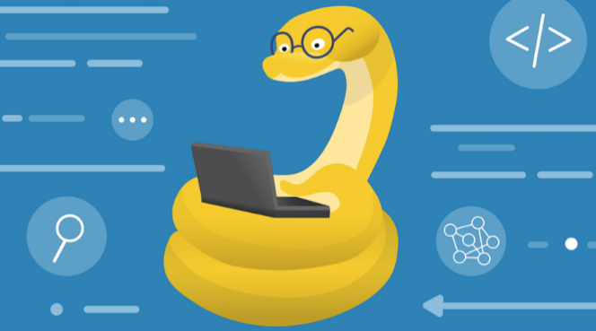
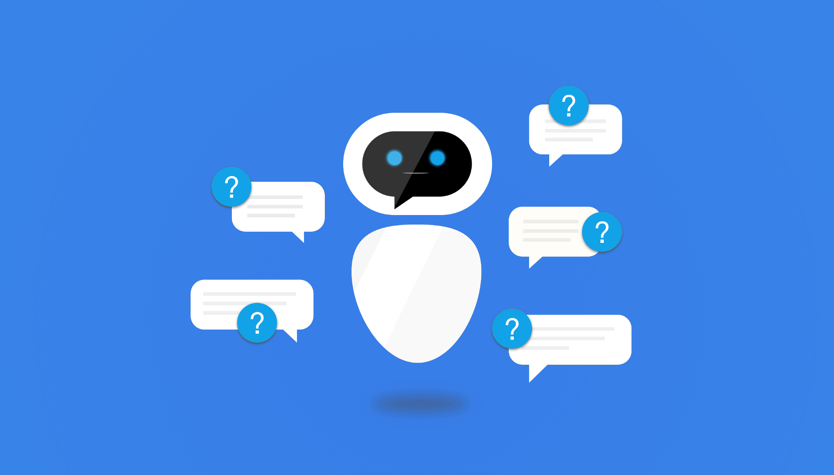
Proposed work and methodology
Understanding the concept of chatbot
Exploring features of Retrieval-based chatbot
Learning the required libraries and packages
Coding and implementation of chatbot in colab

Slide 8
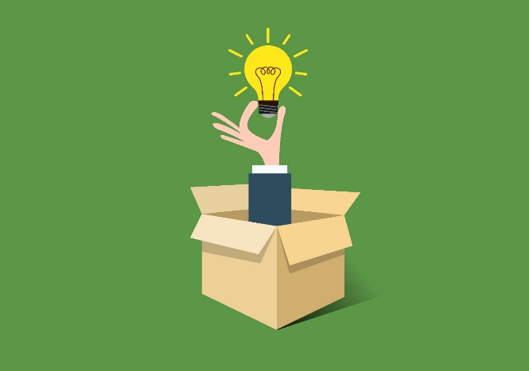
Novelty of the project
Functionality to search beyond the domain

Slide 9

Real time usage
Websites
To find various required information with accuracy

Slide 10
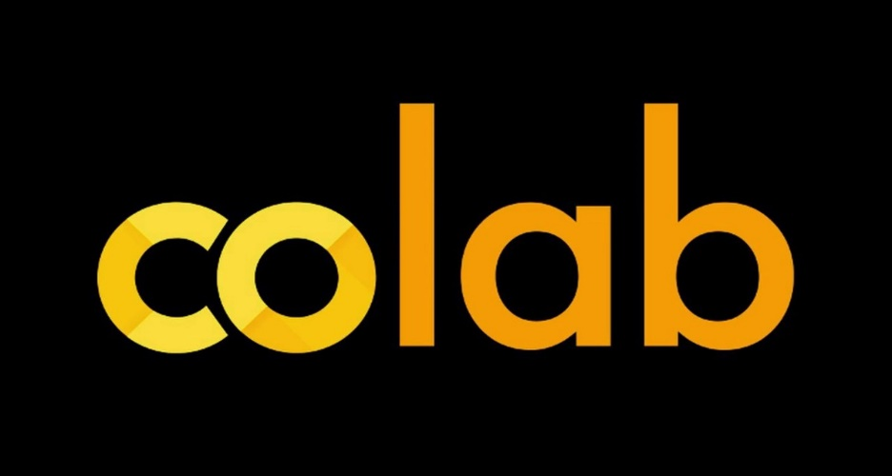
Hardware & Software Requirements
Google Colaboratory

Slide 11
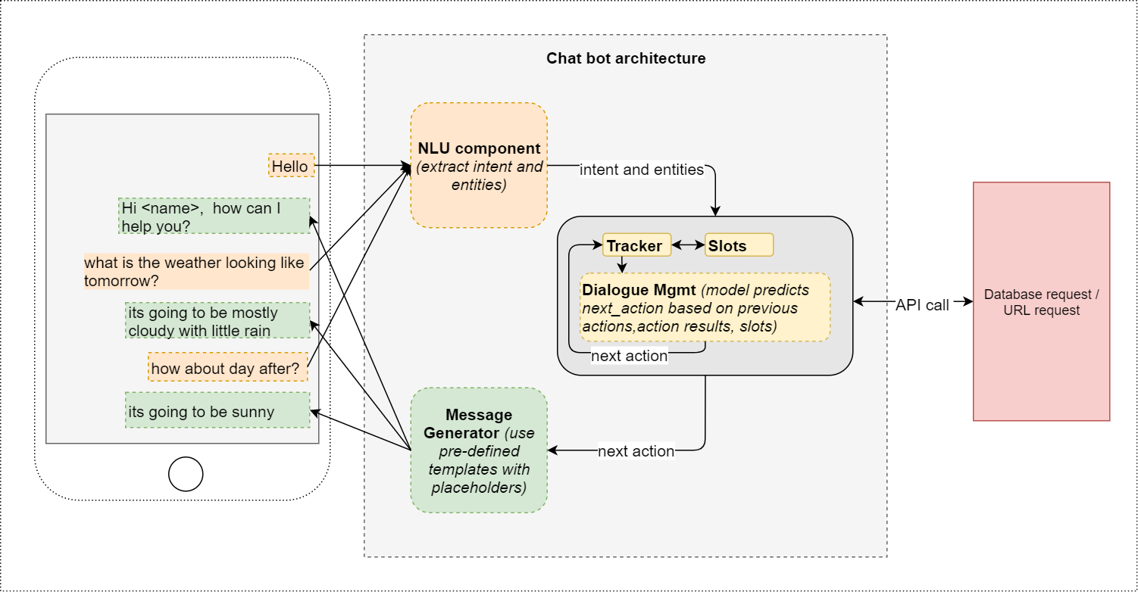
Overall system architecture diagram

Slide 12
Thank You

